Slide 1


BANK LOAN ANALYSIS PRESENTATION

Slide 2
MENTOR DIPTI SINHA
GROUP MEMBERS
ANIKET DEVRUKHKAR
OSAMA AFTAB
PAVITHRA M V
SHANUF CHOUGULE
NAZNEEN SIDDIQUA
ANILKUMAR DAGADA

Slide 3
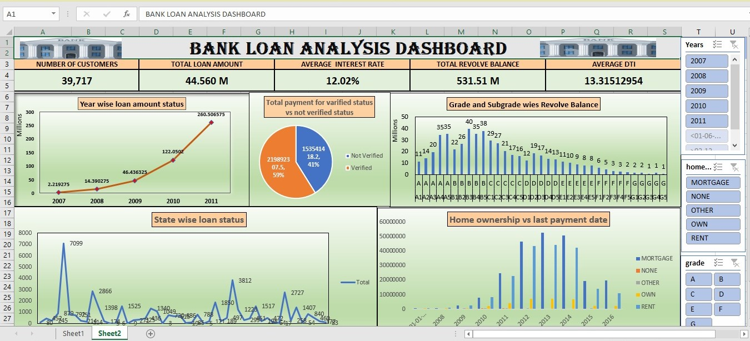
EXCEL DASHB0ARD

Slide 4
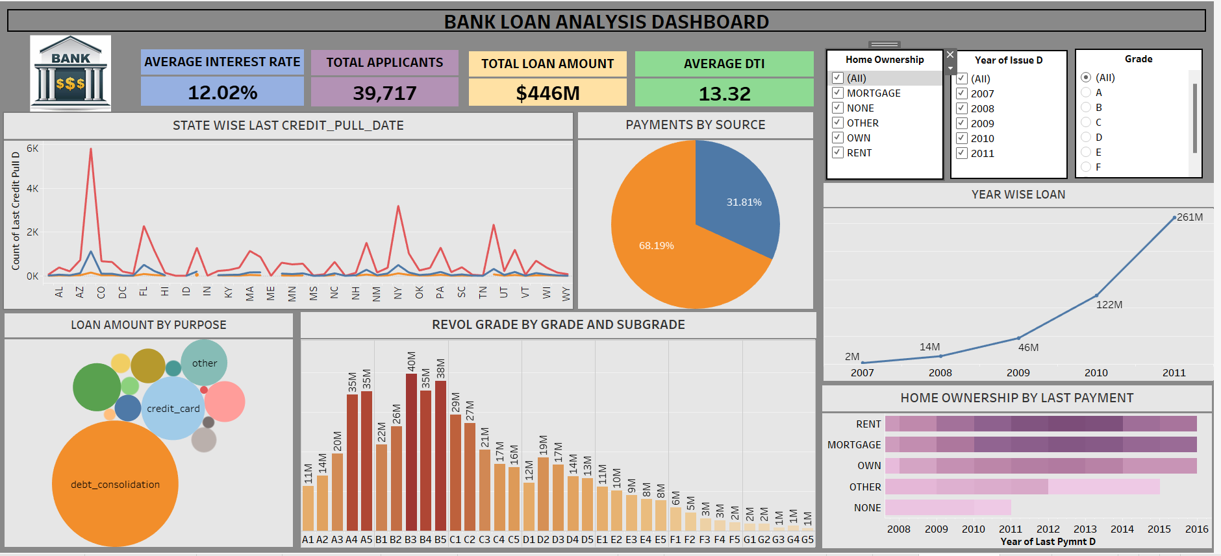
TABLEAU DASHBOARD

Slide 5
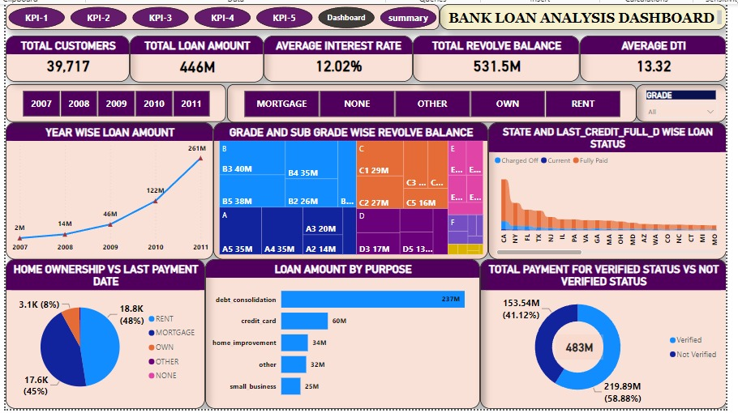
POWER BI DASHBOARD

Slide 6
KeyTAKEAWAYS
LOAN GRADES
Grade B has the highest number of loans, followed by grade A & C.
STATEWISE LOAN ACTIVITY
Fluctuation is observed across various states, indicating varying loan activities over time.
LOAN STATUS
Majority of loans are current followed by fully paids , charged offs being significantly lower.
HOME OWNERSHIP
Mortgage holders tend to have more recent last payments compared to those who rent or own.
VERIFICATION STATUS
Verified loans have higher amount of payments when compared to non- verified.
YEAR-WISE LOAN AMOUNT
There is a clear upward trend in loan amount from 2007 to 2014, indicating growth in lending over the years.

Slide 7
PRECAUTIONS & IMPROVEMENTS
ENSURE CAPITAL RESERVES
Prepare for increasing loan demand by maintaining sufficient capital reserves
ENHANCE VERIFICATION PROCESS
Strengthen verification processes as non-verified users show different payment behaviors
ANALYZE STATE TRENDS
Investigate states with fluctuations to understand underlying causes
MONITOR HIGH-RISK REGIONS
Focus on regions with higher risk grades to mitigate potential defaults
SUPPORT HOMEOWNERS
Address reasons behind late payments or charge-offs among homeowners

Slide 8
SUMMARY
The dashboard provides a comprehensive overview of bank loan data, including key metrics, various charts, and tables. It covers aspects such as interest rates, total applicants, loan amounts and debt-to-income ratios.
There are nearly 39,717 applicants with total amount of loan being taken out $446M.
The average loan interest is 12.02% with 13.32 being average DTI (Debt-To-Income) Ratio.
The total loan amount has increased over the years reaching $261M in 2011, indicating the increase in lending.
Different loans activities are observed across all states with California being the state with highest loan activity.
Breakdown of revol bal by grades and subgrades is observed, Grades B &C have the highest revol-bal.
Verified payments methods are significantly higher to non-verified payments.
The highest number of loan repayment is done by Rent and Mortgage categories which shows higher reliance on home equity loans.

Slide 9

THANK YOU

